Slide 1


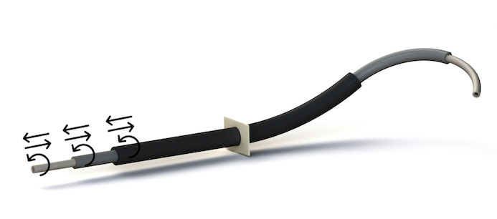
Technical Project:
Medical Robotics
Concentric Tube Robot
STUDENTS PROFESSOR
Catapano Serena Fanny Ficuciello
Gaudino Emanuele
Percuoco Paola
Varone Emanuela
Concentric Tube Robot (CTR) - Group 3 - Final discussion
01/14

Slide 2
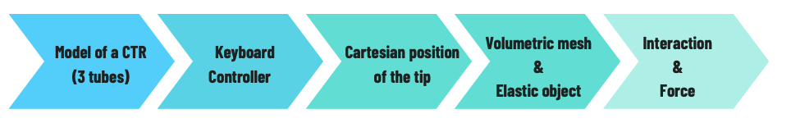
Goal:
implementation of simulation scene in SOFA of a Concentric Tube Robot interacting with an elastic object, trough keyboard command
Workflow:
Concentric Tube Robot (CTR) - Group 3 - Final discussion
02/14

Slide 3



Development environments
a framework that implements a mathematical model describing the phisics around us
a high-level programming language and interactive environment for numerical computation, data analysis, and visualization
an interpreted, object-oriented, high-level programming language with dynamic semantics
Concentric Tube Robot (CTR) - Group 3 - Final discussion
03/14

Slide 4
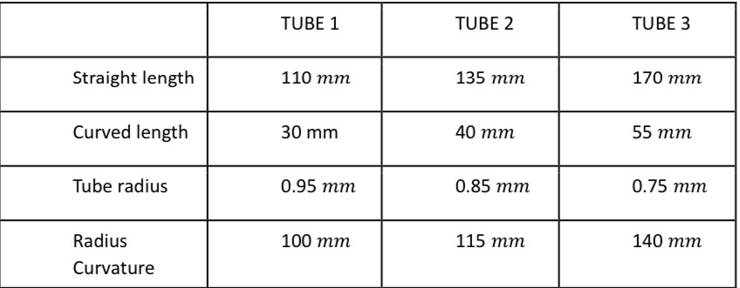
Medical background
Concentric Tube Robots are well suited for minimally invasive surgery inside body cavities.
The design should ensure the capability, for the Robot, to perform a surgical procedure into the body.
Parameters like the lenght (for each of the 3 tubes) and the curvature highly determine the workspace.
The particular composition of concentrically arranged tubes allows for simple, yet dextrous, robotic manipulators.
Actuation is achieved mechanically by relative rotation and axial translation of all the tubes and the motion is a tentacle-like one.
In our case, the design parameters are the following:
Concentric Tube Robot (CTR) - Group 3 - Final discussion
04/14

Slide 5
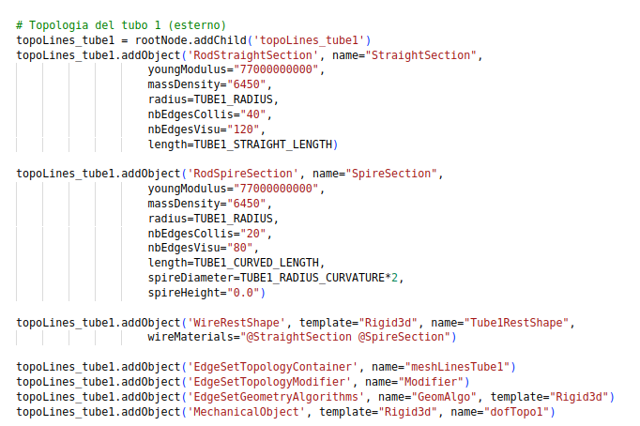
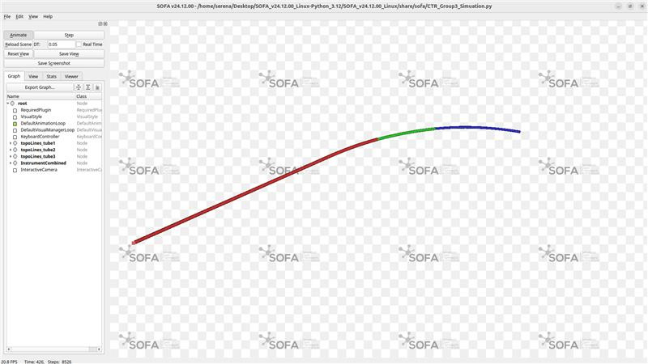
CTR Modelling
Concentric Tube Robots are implemented into the SOFA scene using a .py script which allows to set all the relevant parameters
for the simulation: the ones from the previous table, mostly important for the shaping of the tubes and others about the rigidity of
the tubes and their mass density, which will be determinant in the interaction with a soft or rigid object.
Concentric Tube Robot (CTR) - Group 3 - Final discussion
05/14

Slide 6
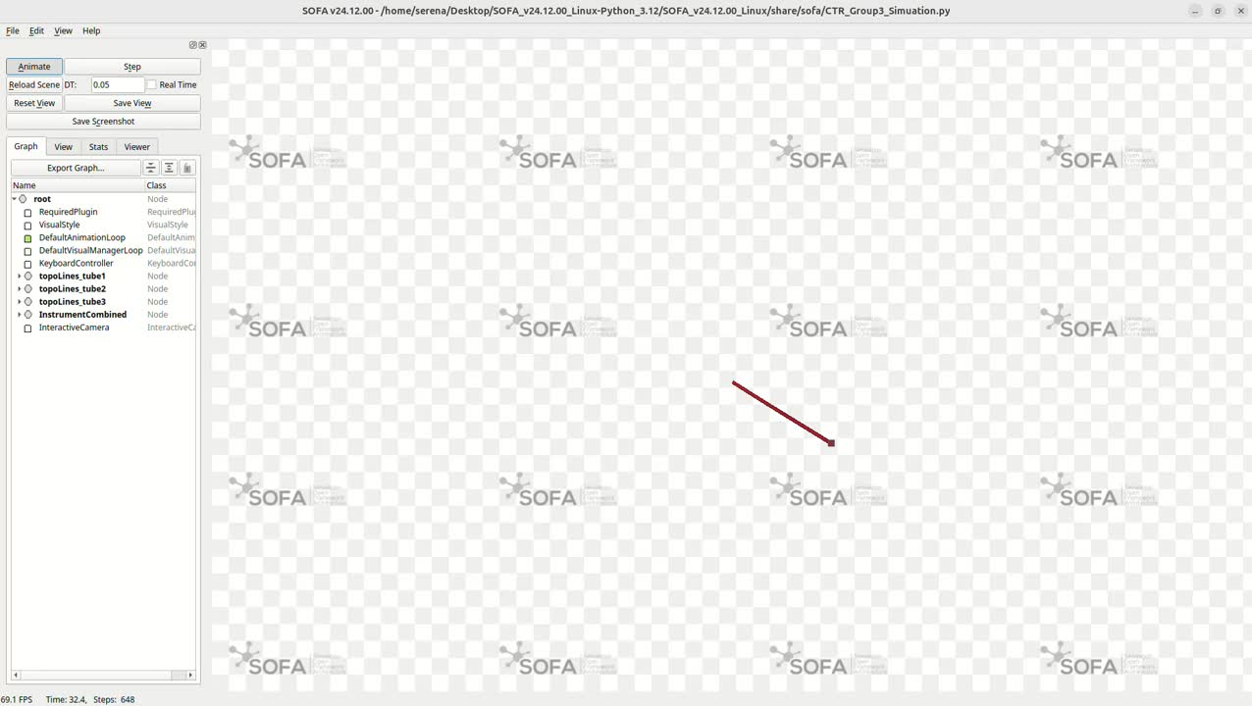
Keyboard controller simulation
The Keyboard Controller is a Python class that provides real-time interactive control of the CTR.
Enables users to manually manipulate individual tubes through keyboard inputs: keys 1-3 select which tube to control, 'u'/'j' for translation (insertion/retraction), and 'h'/'k' for rotation. Additionally, key 't' captures and logs the current tip position to a CSV file, while key 'f' records contact forces between the CTR and surrounding tissues.
The implementation inherits from SOFA's Controller class and overrides the onKeypressedEvent() method to capture keyboard inputs. When movement keys are pressed, it calls the InterventionalRadiologyController's methods (deployControlledInstrument() and rotateControlledInstrument()) to actuate the selected tube.
Concentric Tube Robot (CTR) - Group 3 - Final discussion
06/14

Slide 7
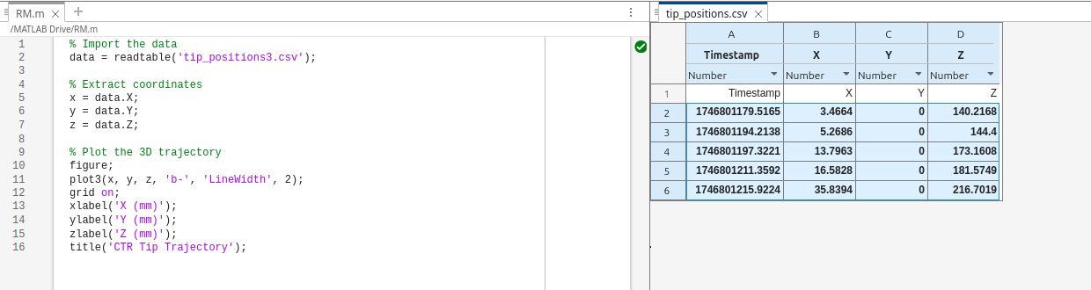
Cartesian position of the tip
To retrive the cartesian position of the tip, the getTipPosition() function has been employed.
Next, the results have been saved within a .csv file.
Finally, using MATLAB, the trajectory followed by the CTR has been poltted in a 3D graph.
Concentric Tube Robot (CTR) - Group 3 - Final discussion
07/14

Slide 8
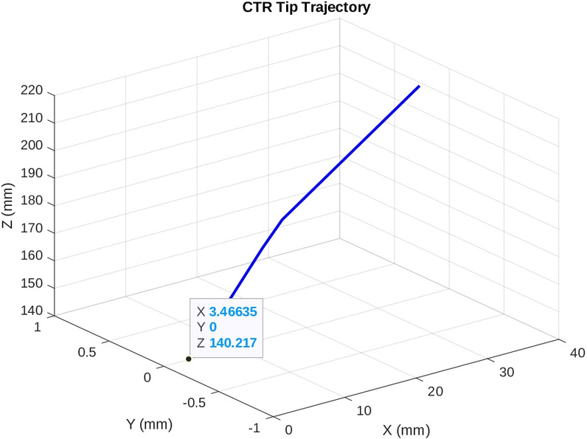
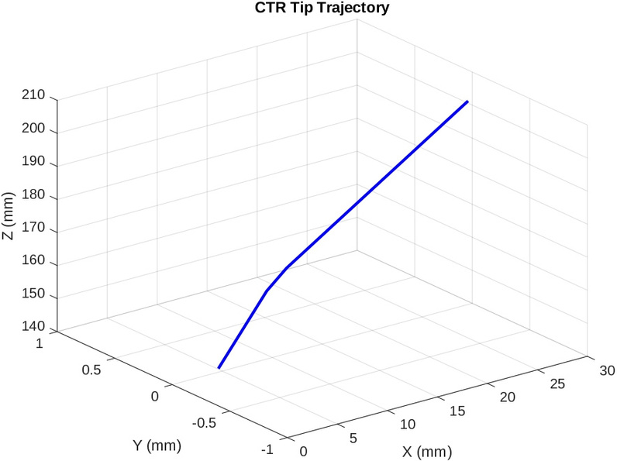
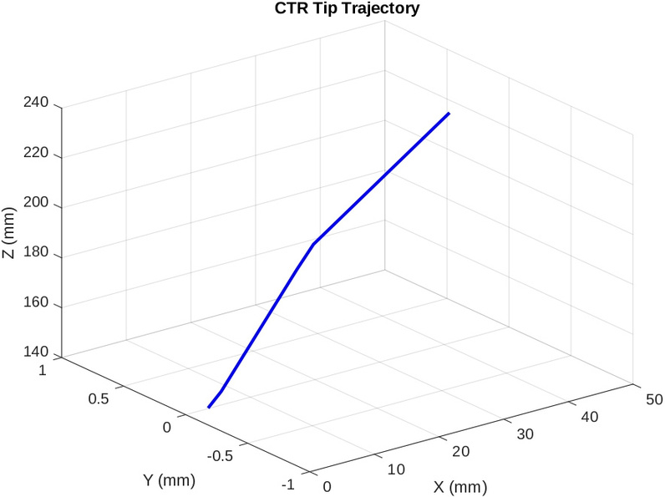
Comparison of the results
+10% CASE:
length of the innermost: 187mm
length of the medium tube:
148.5mm
NOMINAL CASE:
length of the innermost: 170mm
length of the medium tube:
135mm
-10% CASE:
length of the innermost: 153mm
length of the medium tube:
121.5mm
Concentric Tube Robot (CTR) - Group 3 - Final discussion
08/14

Slide 9
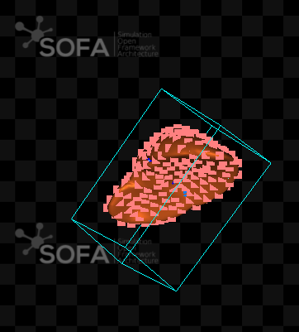
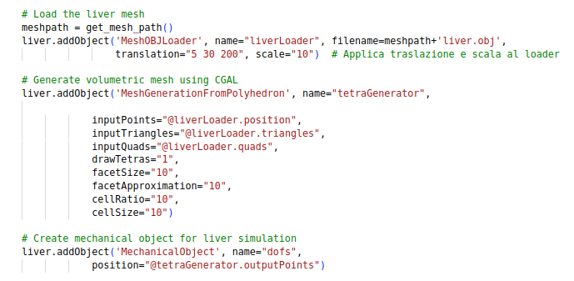
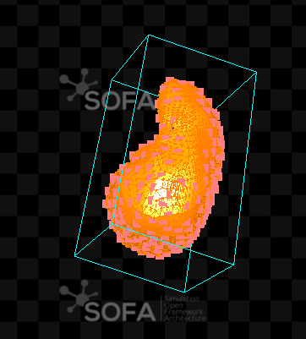
Volumetric mesh & elastic object
The volumetric mesh has been imported in the scene using the provided Python script. It has been employed to generate an elastic object.
Concentric Tube Robot (CTR) - Group 3 - Final discussion
09/14

Slide 10
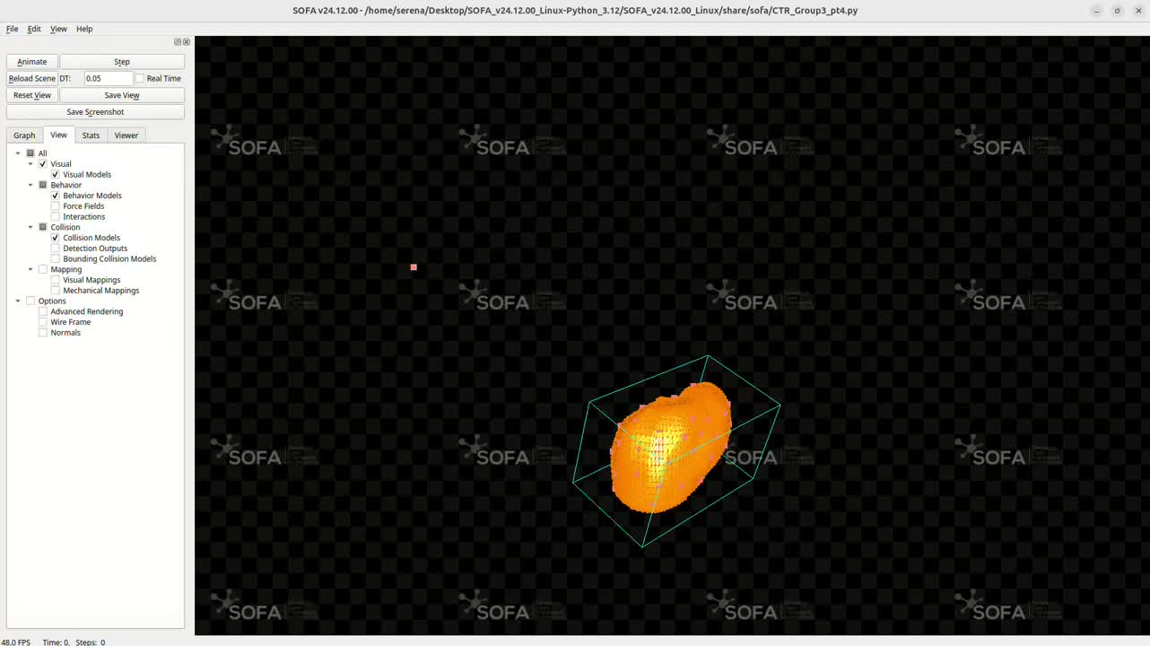
Simulation of the CTR interaction
CASE 1: stiffer object (50e6 Pa)
Concentric Tube Robot (CTR) - Group 3 - Final discussion
10/14

Slide 11
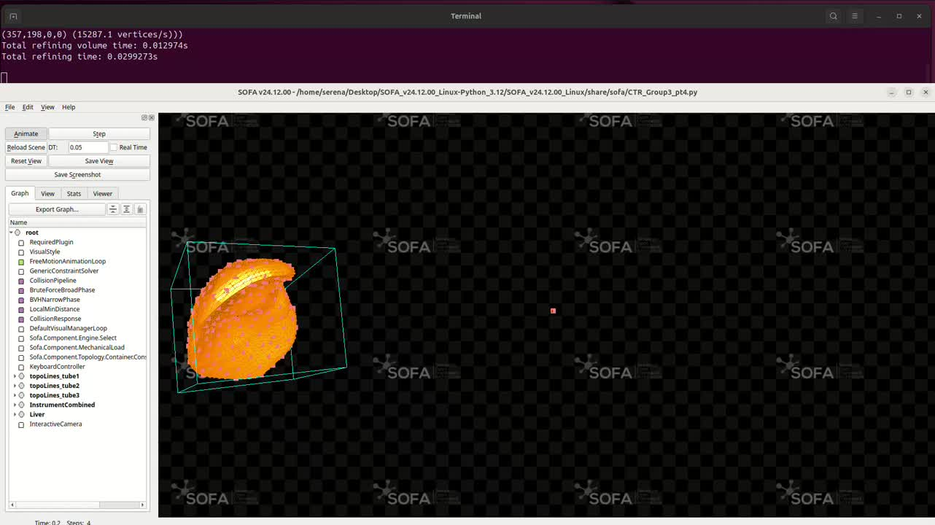
Simulation of the CTR interaction
CASE 2: soft object (2e3 Pa)
Concentric Tube Robot (CTR) - Group 3 - Final discussion
11/14

Slide 12
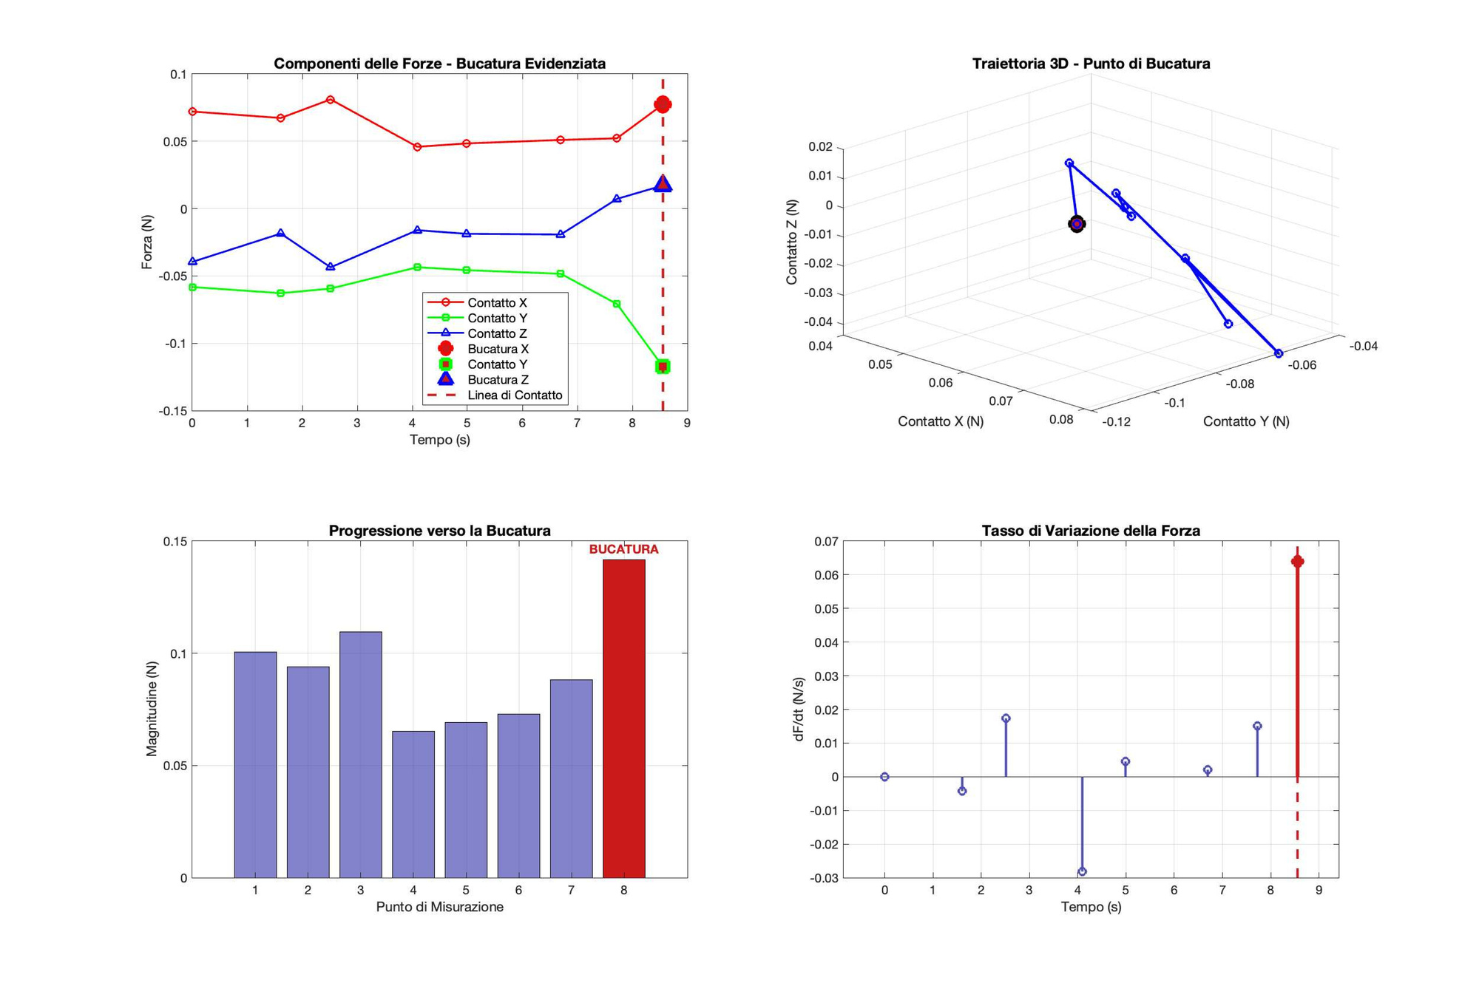
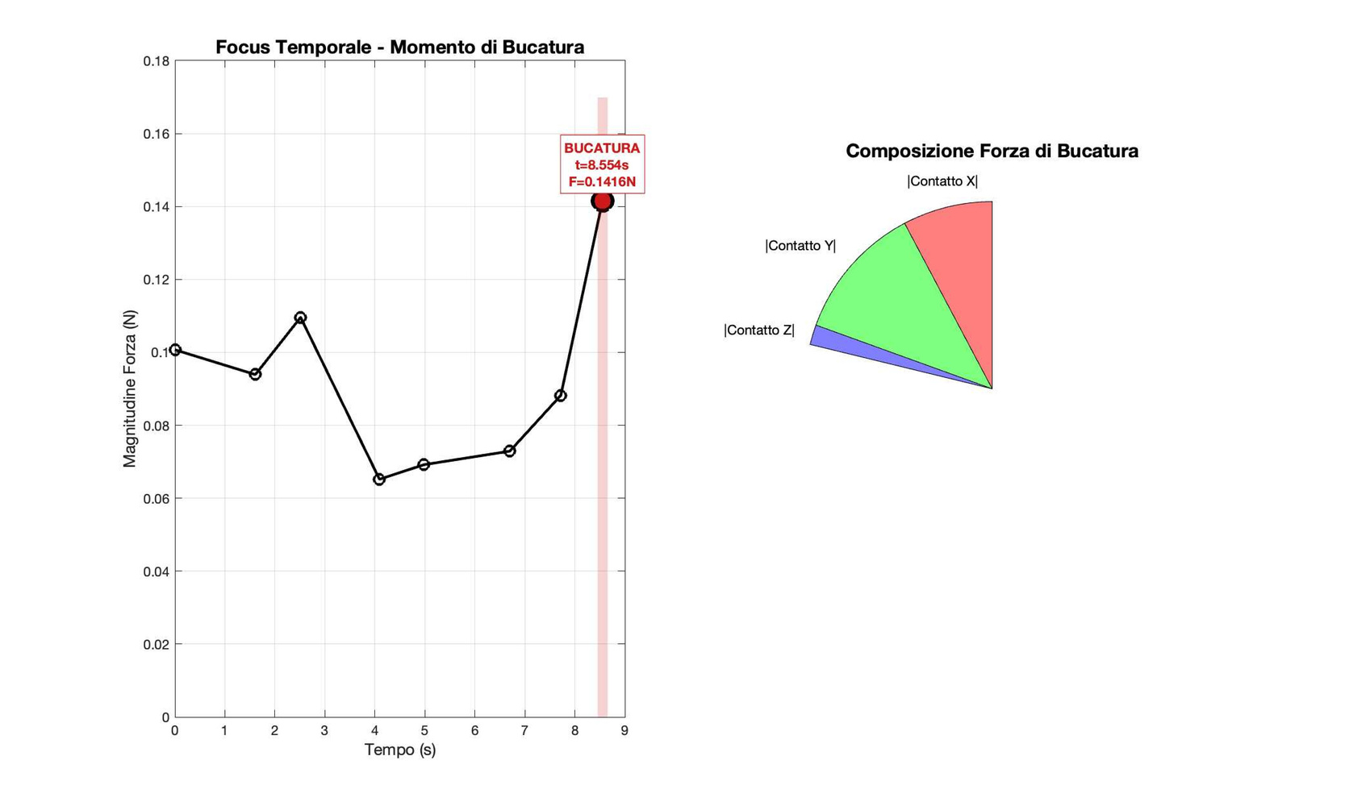
Critical analysis of interaction
Concentric Tube Robot (CTR) - Group 3 - Final discussion
12/14

Slide 13
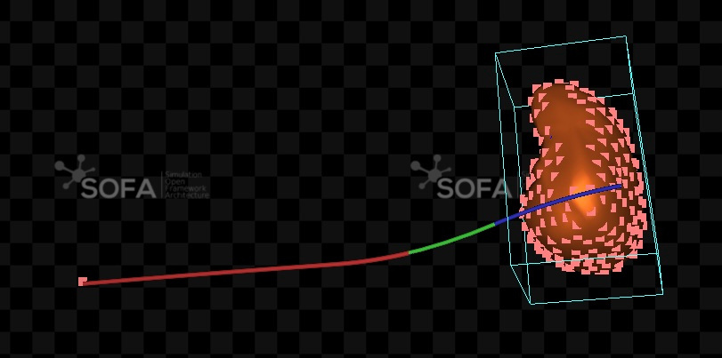
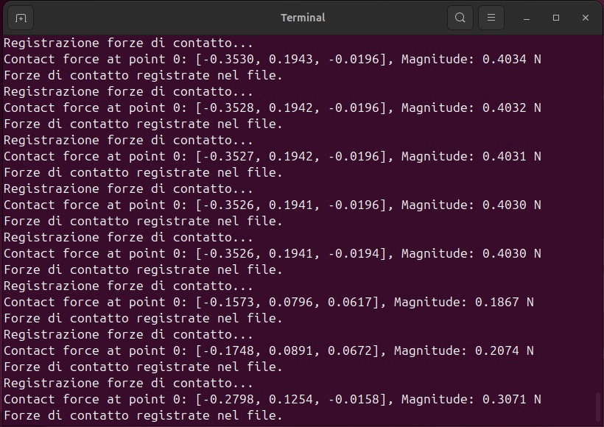
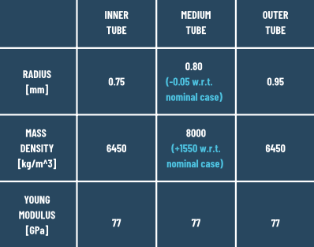
Force registration
Concentric Tube Robot (CTR) - Group 3 - Final discussion
13/14

Slide 14
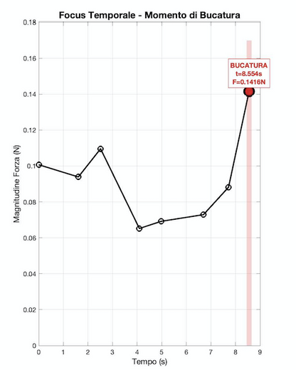
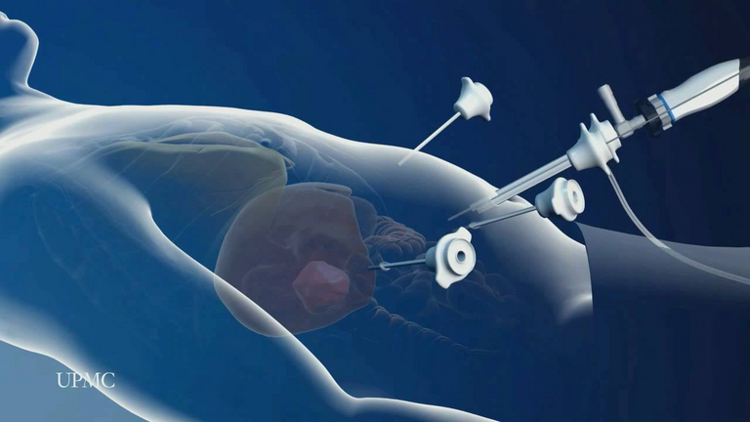
THANKS FOR THE ATTENTION
Concentric Tube Robot (CTR) - Group 3 - Final discussion
14/14

